Slide 1

DATA CLEANING
DERRICK KURIA MUIRU

Slide 2
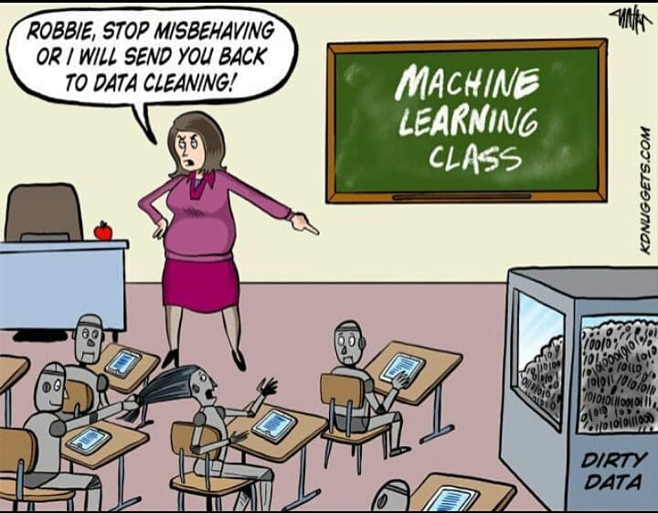

Slide 3

TODAYS DISCUSSION
Data Science RoadMap
What is dirty data?
Types and consequences of dirty data
What is data cleaning and how is it done?
Importance of data quality
Ensuring data quality
Questions

Slide 4

Data Science Process
STEP
STEP
Understanding the problem
STEP
Enrich your data
01
04
STEP
Collecting the Data
STEP
Build Visuals and Models
02
05
STEP
Explore and Clean Your Data
STEP
03
06
Make decisions

Slide 5

What is Dirty Data?
Dirty Data is simply customer or business information that is corrupt, missing, duplicated or inaccurate.
01
Inconsistent data
Duplicated data
04
02
ROT data
05
Excessive Data
03
06
Incomplete data
Inaccurate data

Slide 6
Consequences of dirty data?
01
02
03
04
High Costs
Wrong Decisions
Time Wastage
Distorts Culture
Fixing dirty
Data
Will need added personnel or
Consultants.
Dirty Data results to erroneous data insights hence wrong decisions.
Fixing dirty data takes time to restore the required data validity.
Embracing the Data-driven Culture is neglected with dirty data .

Slide 7

What is Data Cleaning?
Data cleaning, also called data cleansing or scrubbing, deals with detecting and removing errors and inconsistencies from data to improve the quality of data.
Data cleaning is the process of ensuring that your data is correct, consistent, and usable.
.

Slide 8

How to do Data cleaning?
Getting rid of unwanted observations: Removing observations that aren’t relevant to the problem you’re trying to solve.
Unifying the data structure: You’ll need to ensure data from different sources is consistent by mapping it to a unified underlying structure.
Standardizing your data: This involves things like ensuring the numerical observations in your dataset use the same unit of measurement.
Removing unwanted outliers: Outliers can be useful, but if they’re erroneous they’ll skew the results of your analysis. You’ll need to make a judgment call about which outliers to keep and which to remove.
Fixing cross-set data errors: Data rarely comes from a single source; ensuring that different data sources don’t contradict each other is vital.

Slide 9
How to do Data cleaning
Resolving type conversion and syntax errors: This involves things like removing whitespace, checking for spelling mistakes, or simply ensuring data is categorized correctly. For instance, are number fields properly labelled as numerical data?
Dealing with missing data: If there are gaps in your data, what effect will this have? You might choose to remove associated entries, guess missing values, or simply flag them so you can measure their impact later.
Remove Oversamples: This is data that was not expected in the collection phase
Remove Nonsense Answers and Unreadable Data: This is data that was collected but does not add value to the data.
Validating your data: This is the final step of the process. It usually involves executing scripts that check if you’ve carried out all the other steps of the process correctly. You’ll often have to go back and repeat some of the earlier steps.

Slide 10

Avoiding dirty data for small scale
01
Use Selections and dropdowns whenever
Possible instead of text boxes for filling answers
02
Make all important questions required to avoid missing data for important data
The target criteria should be well outlined
To ensure that the answers are
relevant
03
04
Avoid straight liners and
nonsensical/Inconsistent answers in
surveys

Slide 11








To avoid dirty data?
Make quality data a priority
Across all teams, make an enterprise-wide data strategy and create clear user roles.
Standardization
Deciding how to input different attributes of Data. E.g., for names of it first name, Last Name or Full Name
Automate Data entry
Most dirty data is manually input hence need to reduce human error, Autocompletes and monitored OCR can assist .
Data Champions
ENTERPRISE
Introducing data reviews
Assigning dedicated person(s) to administer CRM processes to help maintain data standards
Data teams should observe different data entered by different teams and give scores.
Integrate CRM with other tools
Prevent Don’t just cure
To have a consolidated source of tracking data will enable cleaning to only happen on one tool.
For Duplicates, create duplicate detection rules so that by identifying you already know that entry exists
Create a data quality Dashboard
Have a dashboard that displays the extent of dirty data. Also create metrics that show the cleanliness of data on business dashboards

Slide 12
… ‘With Data, “the sooner the better” is always the best answer.’
- MARISSA MAYER

Slide 13

QUESTIONS
Twitter- Kuria_muiru
LinkedIn- Derrick Kuria Muiru

